Slide 1
Correlation and Causation of Eye-Brain Axis Revealed by Network Propagation and Multivariable Mendelian Randomization
吳欣俞

Slide 2
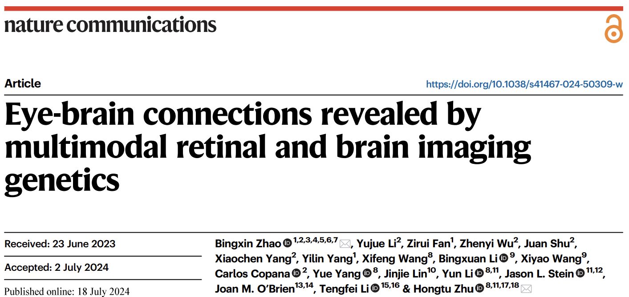

Slide 3
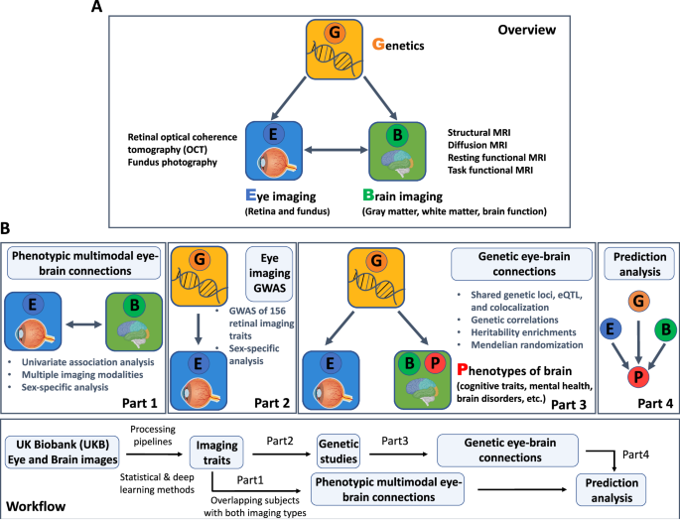

Slide 4
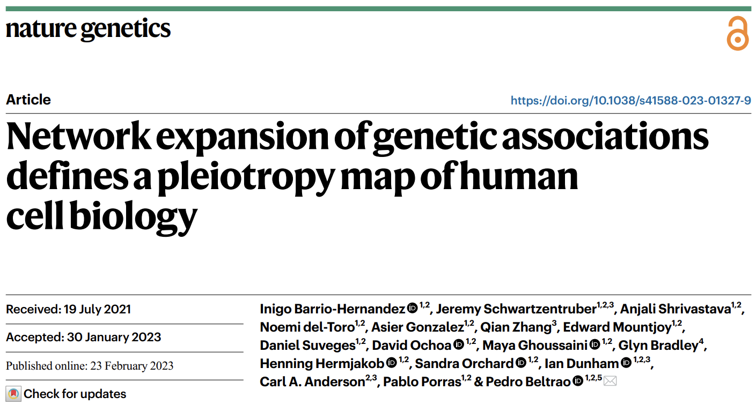

Slide 5
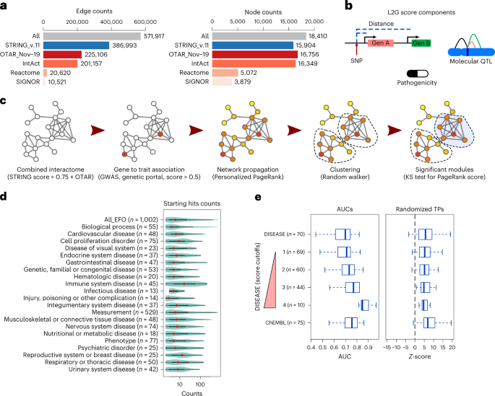

Slide 6
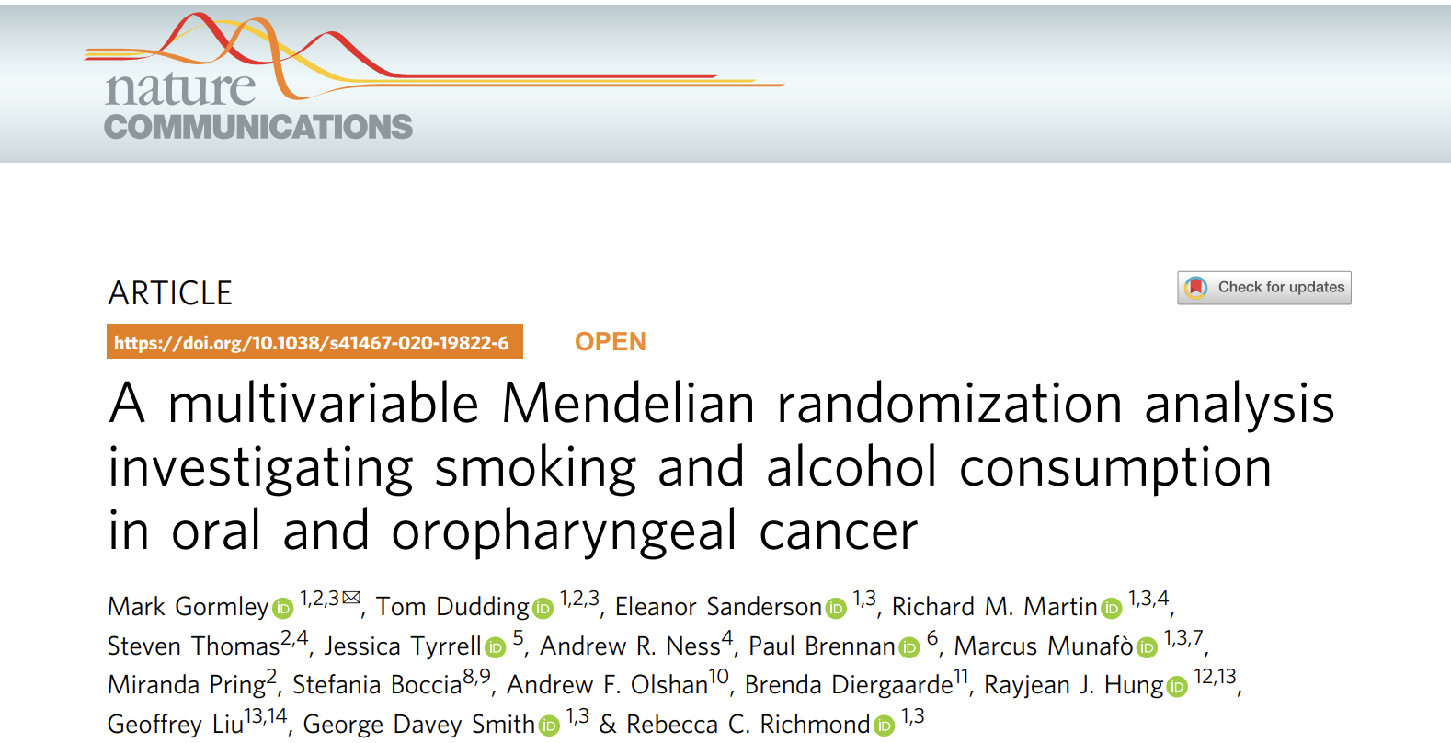

Slide 7
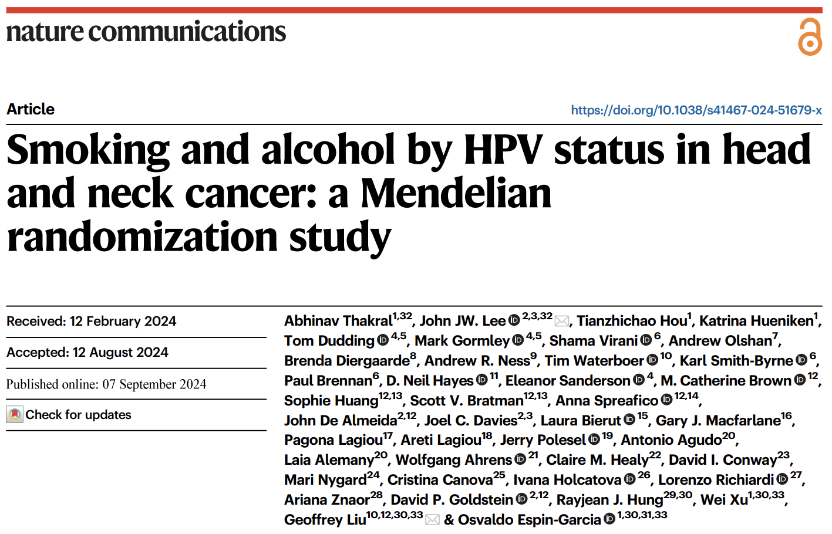

Slide 8
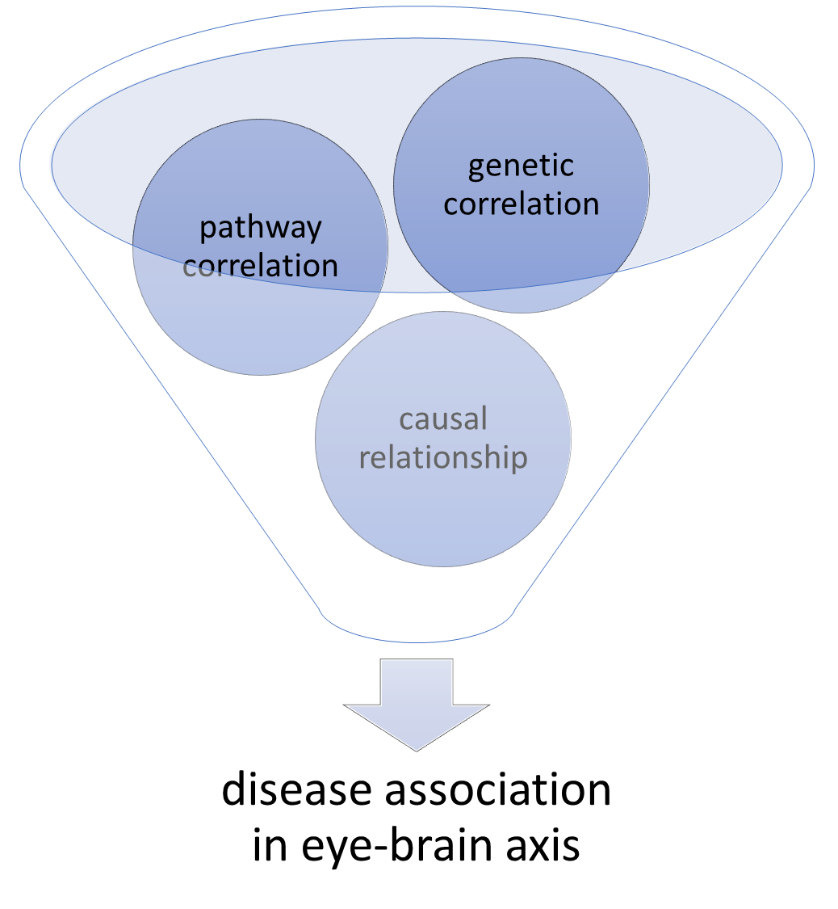

Slide 9
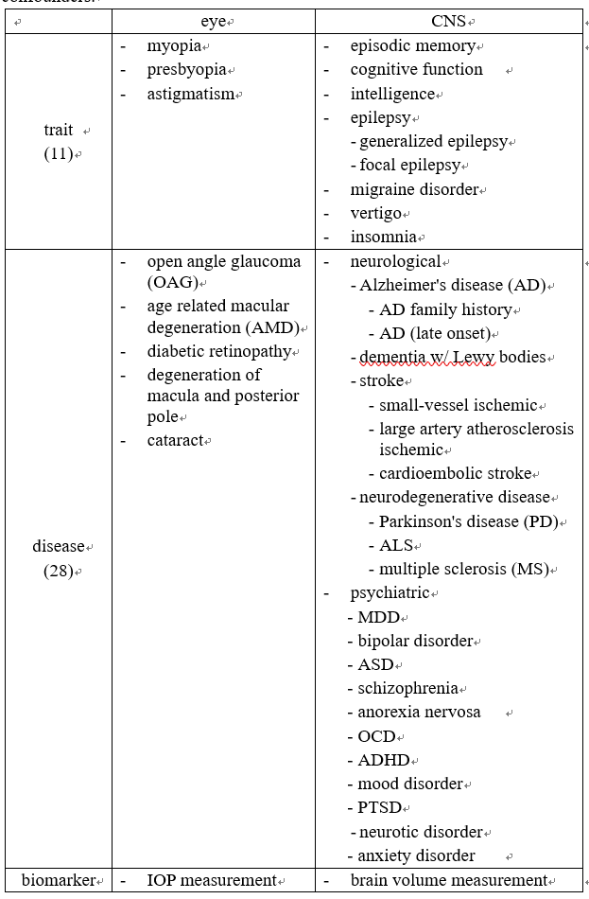
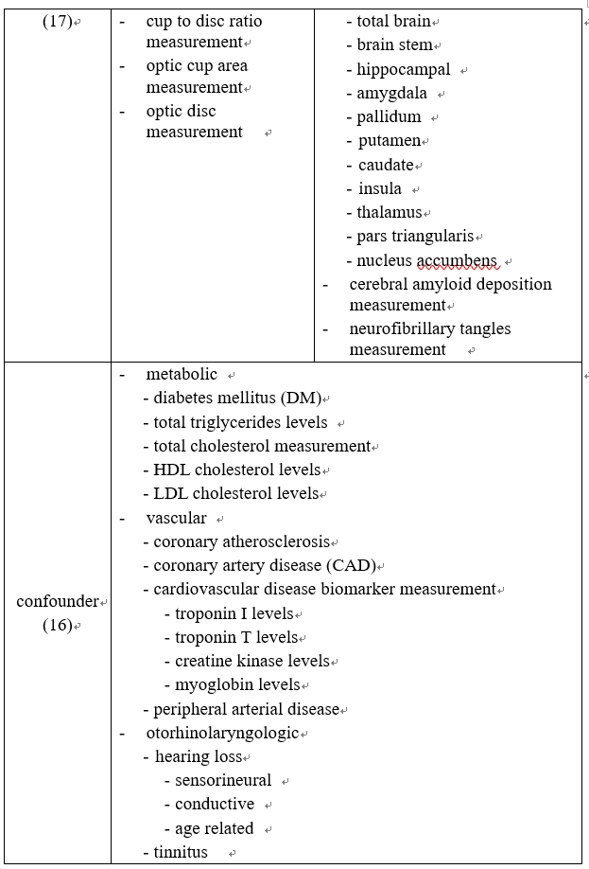

Slide 10
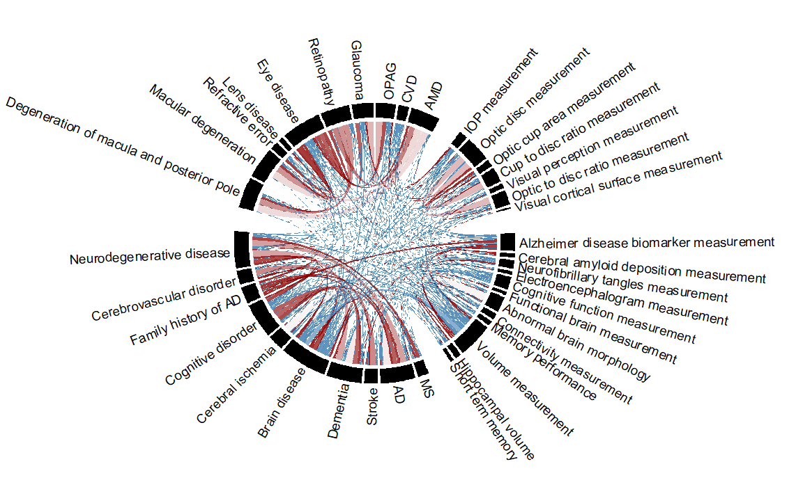
eye disease
eye biomarker
CNS disease
CNS biomarker

Slide 11
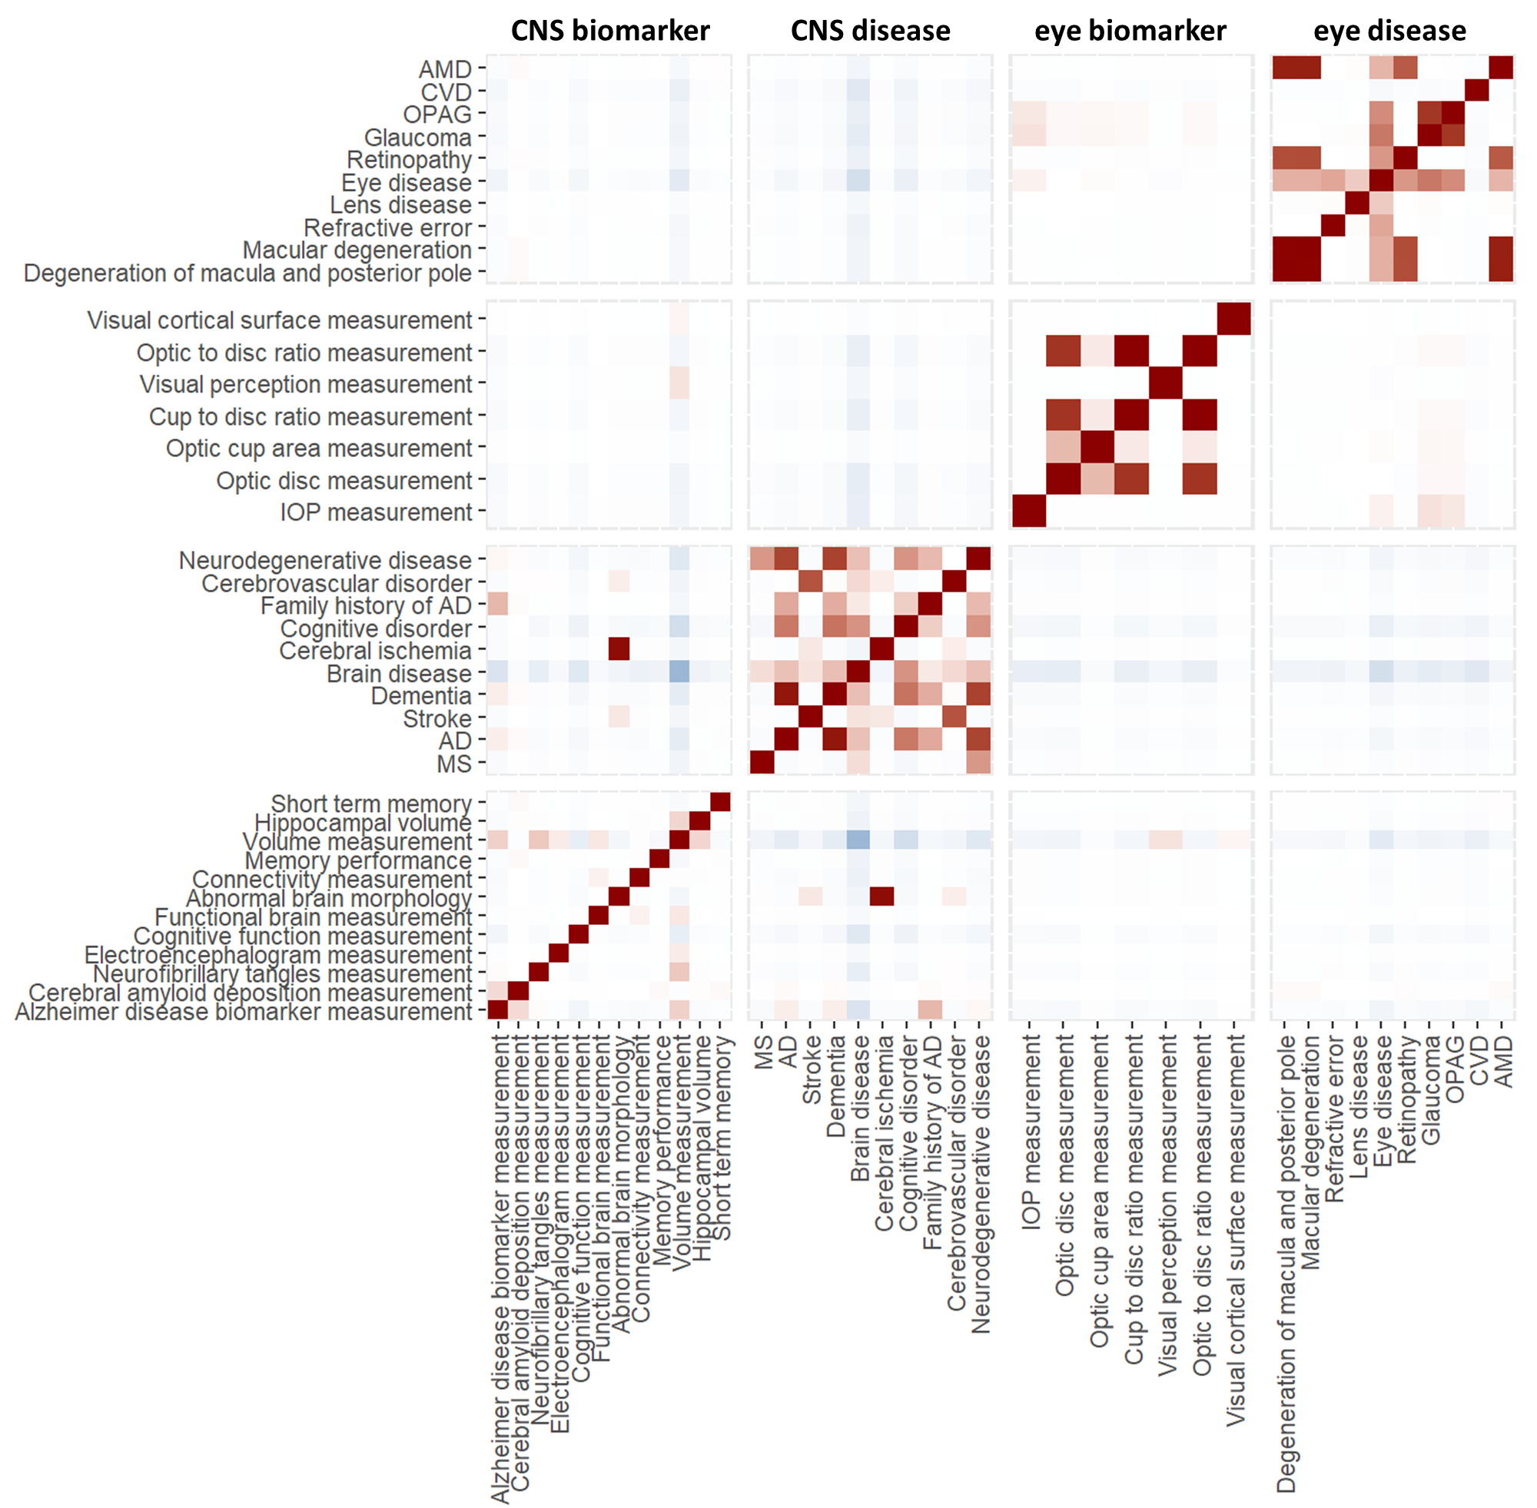
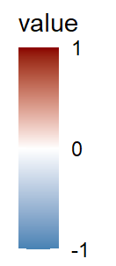

Slide 12
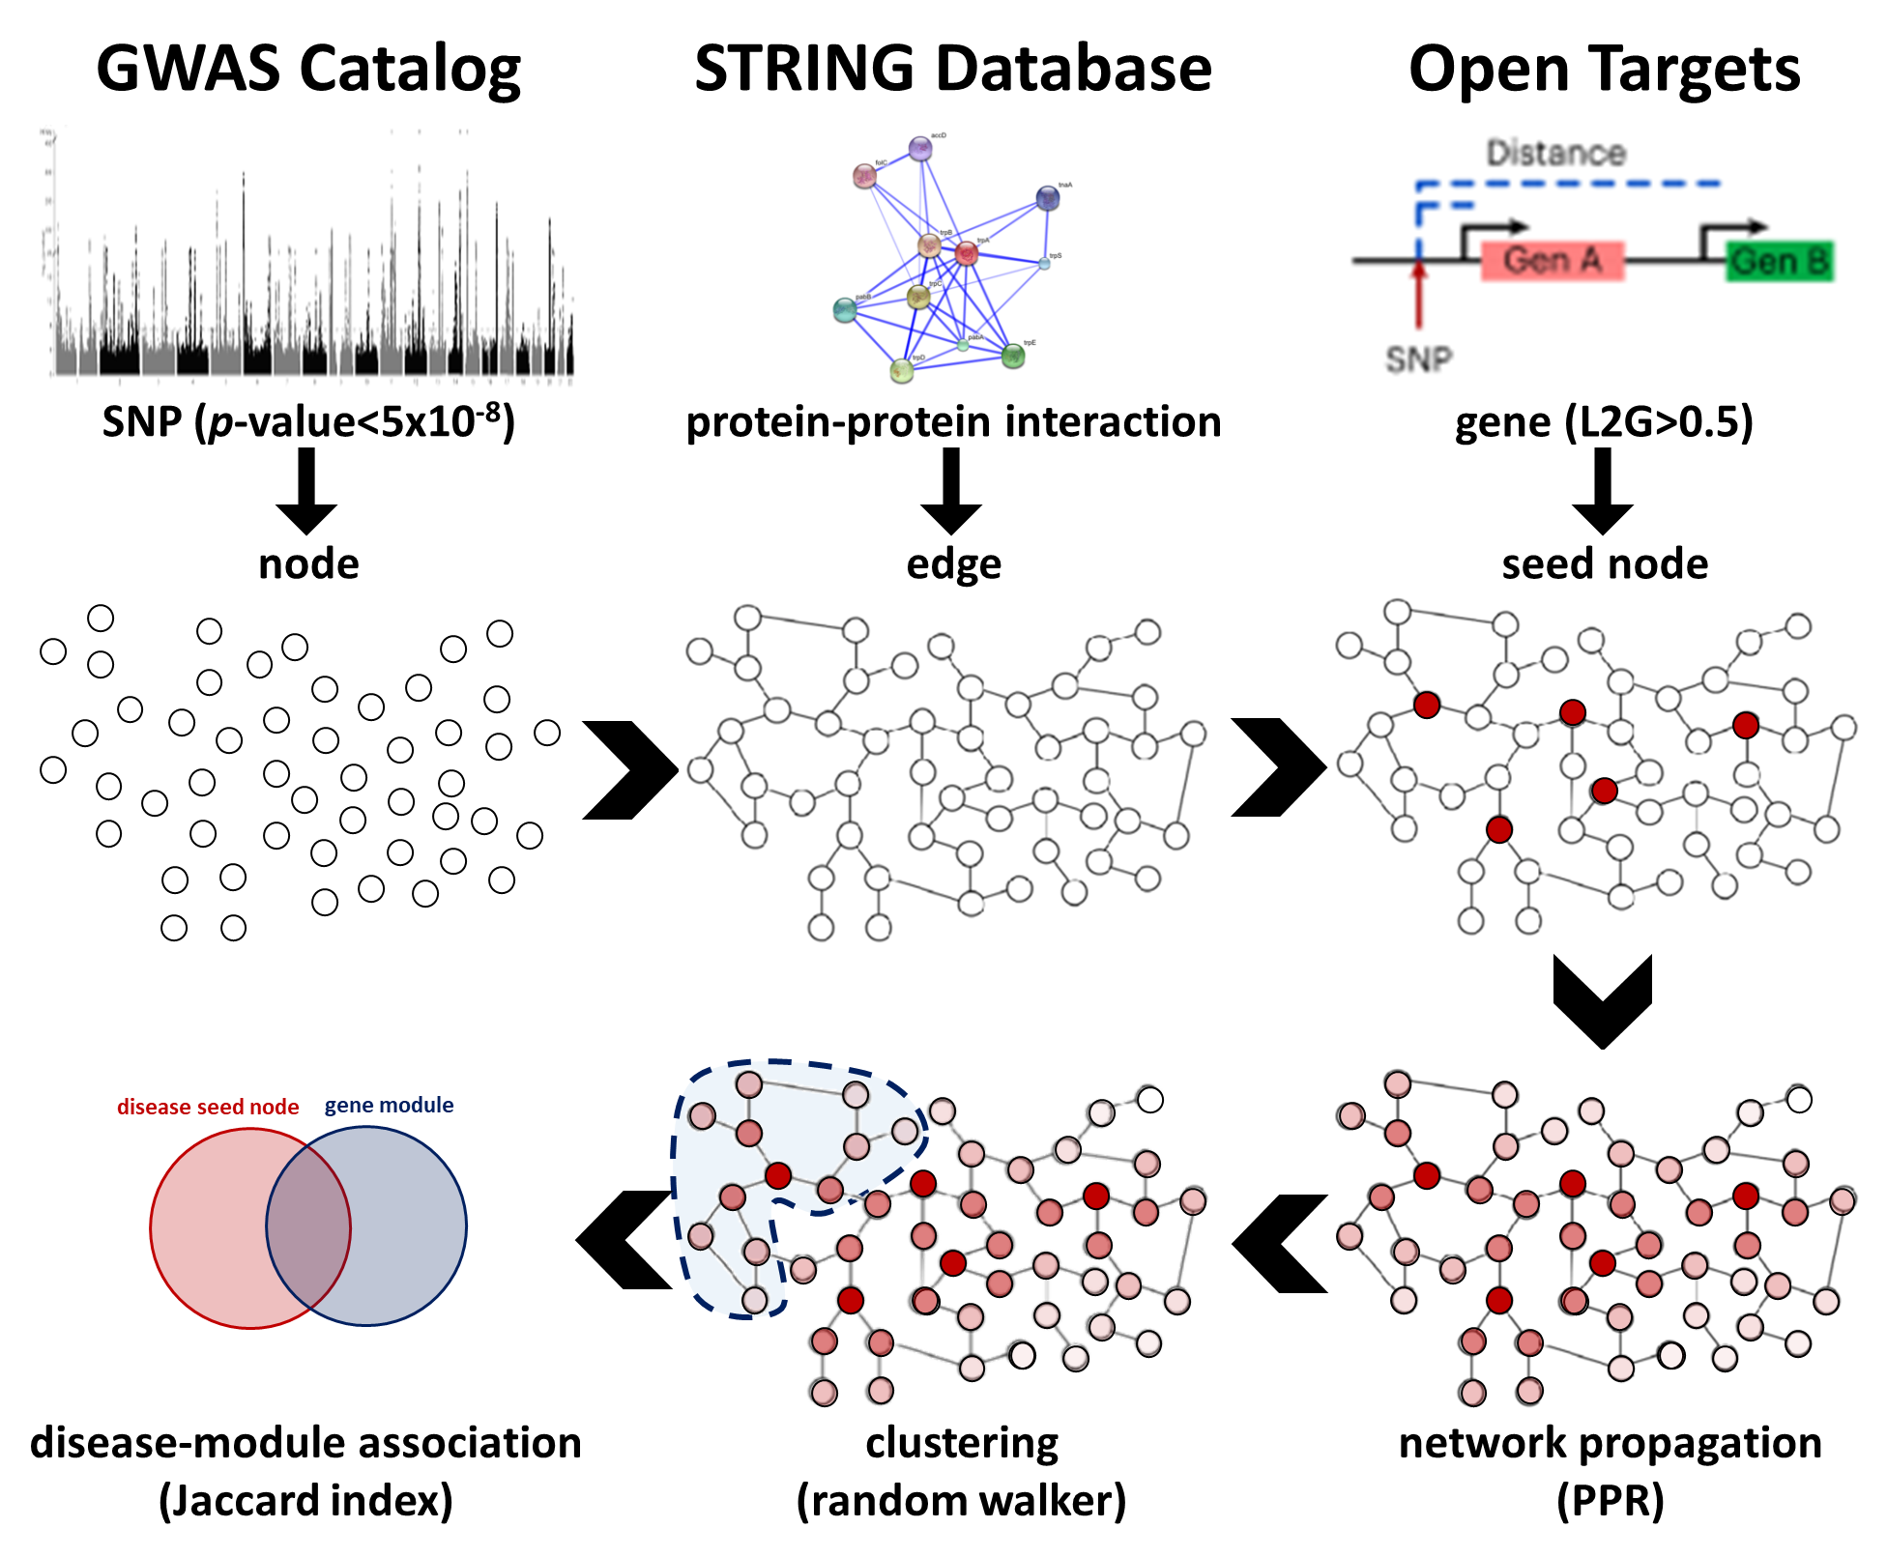
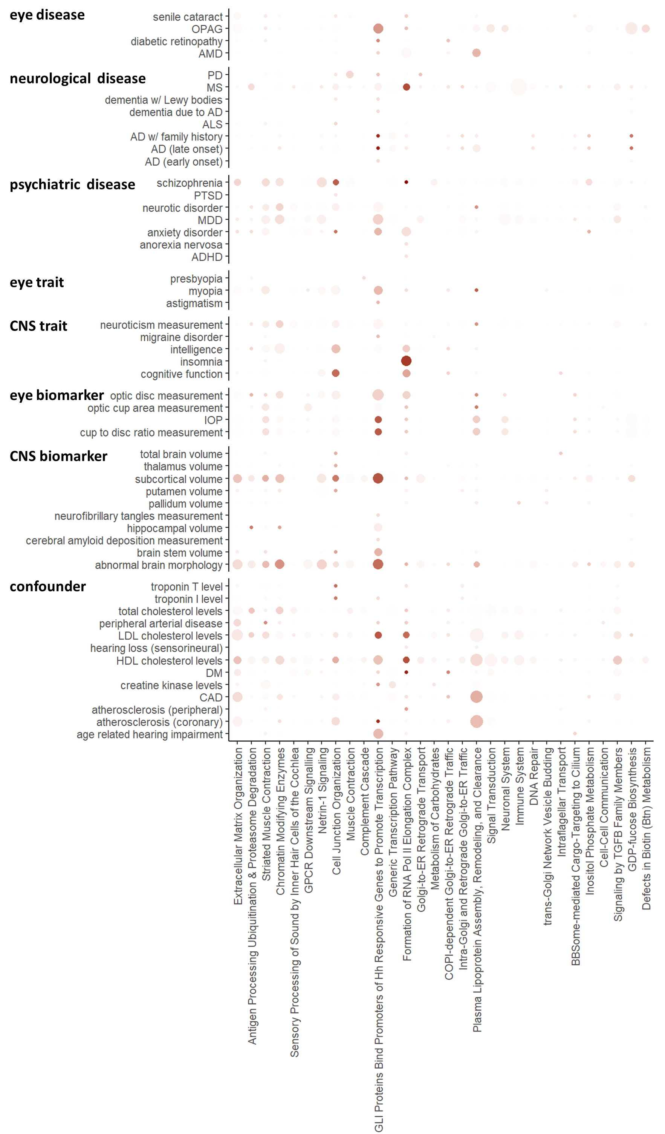
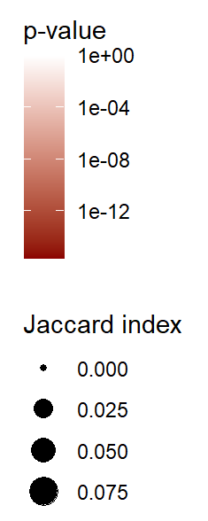

Slide 13
Figure
abstract figure
genetic correlation (circular & table)
phenotype vs gene cluster w/ pathway的圖表，左邊加上phenotype 樹狀圖
PPI of gene cluster w/ drug repurposing target (ChEMBL )
選幾個Meta的Manhattan，如果可以，找到跨種族都成立的peak，然後附幾個alphafold 的圖畫SNP mutation對protein的影響
MVMR的結果 (table, scatterplot)
如果有順利找到合適的方式算R²看genetic, pathway, causal這三個的比例，目前想到的是畫78x78的圖表，每個點一個圓餅圖之類的

Slide 14
Highlights
genetic correlation+pathway correlation+causal relationship
=disease association
drug repurposing target
cross-organ biomarker as disease predicter

